Slide 1


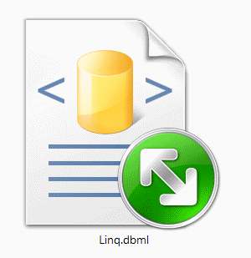
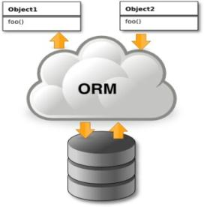
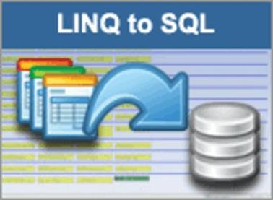
LINQ to SQL
ORM Concepts, LINQ to SQL, DataContext
Svetlin Nakov
Telerik Corporation
www.telerik.com

Slide 2

Table of Contents
ORM Technologies – Basic Concepts
LINQ to SQL
Overview
LINQ Components
LINQ to SQL Files
The Visual Studio Designer
DataContext Class and CRUD Operations

Slide 3
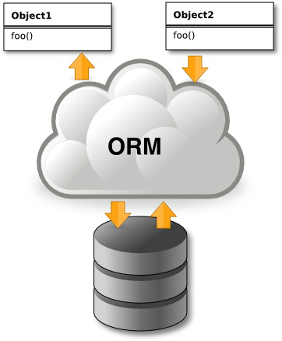
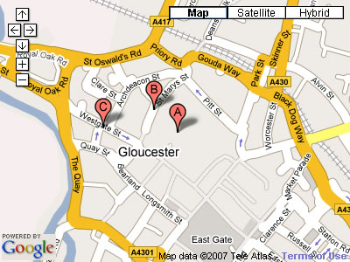


Introduction to ORM
Object-Relational Mapping (ORM) Technologies

Slide 4
ORM Technologies
Object-Relational Mapping (ORM) is a programming technique for automatic mapping and converting data
Between relational database tables and object-oriented classes and objects
ORM creates a “virtual object database“
Which can be used from within the programming language, e.g. C# or Java
ORM frameworks automate ORM process
A.k.a. object-relational persistence frameworks

Slide 5
ORM Frameworks
ORM frameworks typically provide the following functionality:
Creating object model by database schema
Creating database schema by object model
Querying data by object-oriented API
Data manipulation operations
CRUD – create, retrieve, update, delete
ORM frameworks automatically generate SQL to perform the requested data operations

Slide 6
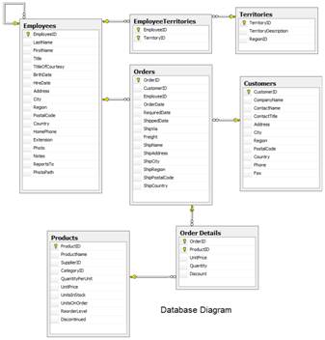
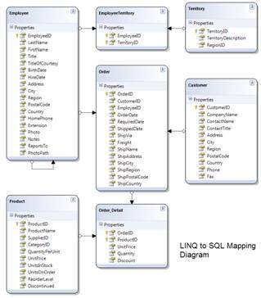




ORM Mapping – Example
Database and LINQ to SQL mapping diagrams for a subset of the Northwind database
Relational database schema
ORM Entities (C# Classes)
ORM
Framework

Slide 7
ORM Advantages
Object-relational mapping advantages
Developer productivity
Writing less code
Abstract from differences between object and relational world
Complexity hidden within ORM
Manageability of the CRUD operations for complex relationships
Easier maintainability

Slide 8
Approaches to ORM
Template-based code generation vs. entity classes mappings
SQL generation (design time / runtime) vs. mapping existing SQL
Entity classes representation
Entities are just POCO (Plain Old C# Objects)
Entities implement special IPersistent interface or extend PersistentBase class
Configuring mappings
DB schema data vs. XML vs. annotations

Slide 9
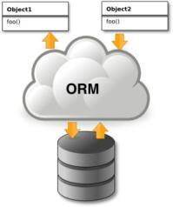
Object Persistence Frameworks
Code generation tools
Generate C#, XML and other files
Source code is compiled and used as API
Can be highly customized
Object-relational mapping tools
Mappings are described in XML files or built in the classes as attributes
No source code generation
Use of single standard API

Slide 10
ORM Frameworks in .NET
Built-in ORM tools in .NET Framework and Visual Studio
LINQ to SQL
ADO.NET Entity Framework
Both combine entity class mappings and code generation, SQL is generated at runtime
Third party ORM tools
NHibernate – the old daddy of ORM
Telerik OpenAccess ORM

Slide 11


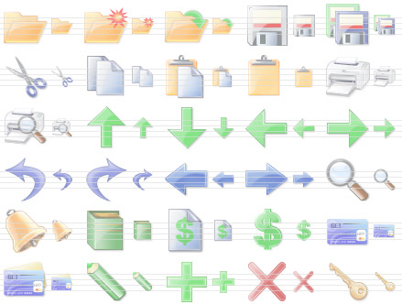
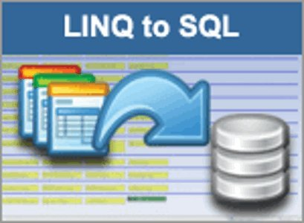
LINQ to SQL
Object Relation Mapping Framework

Slide 12
Overview of LINQ to SQL
LINQ to SQL is a standard ORM framework, part of .NET
Provides a run-time infrastructure for managing SQL Server data as .NET objects
The relational database schema is mapped to an object model (classes and associations)
Visual Studio has built-in tools for generating LINQ to SQL data mappings
Data mappings consist of C# classes and XML
A standard data manipulation API is provided

Slide 13
Overview of LINQ to SQL (2)
LINQ to SQL is an application programming interface (API)
For working with SQL Server databases
Built on the top of ADO.NET and LINQ
LINQ to SQL is Microsoft’s entry-level LINQ-enabled ORM implementation for SQL Server
Works with SQL Server and SQL Server Express
Maps tables and one-to-many relationships
Can not map many-to-many relationships

Slide 14
LINQ to SQL Features
LINQ to SQL standard features:
Map tables, views, stored procedures and functions as objects
Provides LINQ-bases data queries
Executed as SQL SELECTs on the DB server
CRUD operations – Create/Read/Update/Delete
Create compiled queries – for executing the same parameterized query multiple times
Creating or deleting the database schema

Slide 15
LINQ to SQL Lifecycle
When the application starts
LINQ to SQL translates into SQL the language-integrated queries in the object model
Sends them to the database for later execution
When the database returns the results
LINQ to SQL translates them back to objects
The DB is transparent, hidden behind the API
LINQ is executed over IQueryable<T>
At compile time a query expression tree is emitted
At runtime SQL is generated and executed

Slide 16
LINQ Components
The DataContext class
DataContext holds the connection to the database and the entity classes
Provides LINQ-based data access
Implements identity tracking, change tracking, and API for CRUD operations
Entity classes
Each database table is typically mapped to a single entity class

Slide 17
LINQ Components (2)
Associations
An association is a primary key / foreign key based relationship between two entity classes
Allows navigation from one entity to another, e.g. Student.Courses()
Concurrency control
LINQ to SQL uses optimistic concurrency control
Provides automatic concurrency conflict detection and means for conflicts resolution

Slide 18
LINQ to SQL Files
Visual Studio has built-in LINQ to SQL data designer and code generator
Mappings are stored in .dbml files (Data Base Markup Language)
<database>.dbml is an XML file
Holds a connection string and metadata representing the database schema
<database>.cs file contains the entity classes and the Data Context class
One entity class for each mapped database table

Slide 19
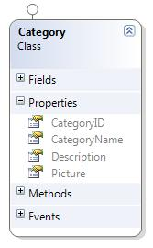
LINQ to SQL Files – Example
DBML mappings file for the Categories table from Northwind database in SQL Server
<Table Name="dbo.Categories" Member="Categories">
<Type Name="Category">
<Column Name="CategoryID" Type="System.Int32" DbType="Int NOT NULL IDENTITY" IsPrimaryKey="true" IsDbGenerated="true" CanBeNull="false" />
<Column Name="CategoryName" Type="System.String" DbType="NVarChar(15) NOT NULL" CanBeNull="false" />
<Column Name="Description" Type="System.String" DbType="NText" CanBeNull="true" UpdateCheck="Never"/>
<Column Name="Picture" Type="System.Data.Linq.Binary" DbType="Image" CanBeNull="true" UpdateCheck="Never" />
</Type>
</Table>
Entity class Category

Slide 20

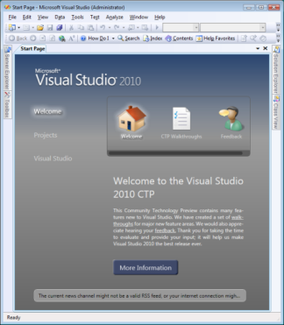

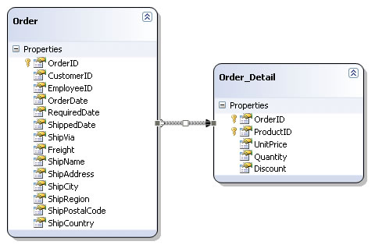
The LINQ to SQL Designer in Visual Studio
Live Demo

Slide 21
The DataContext Class
DataContext class is generated by the VS designer
DataContext provides:
Ability to manipulate SQL data though entity classes (read, modify, delete, insert)
Easily navigate through the table relationships
Executing LINQ queries as corresponding native SQL queries
Create new databases its database schema

Slide 22
Using DataContext Class
First create instance of DataContext
In the constructor you can pass a DB connection and mapping source
DataContext properties
Connection – the SqlConnection to be used
CommandTimeout – timeout for SQL execution
Log – stream for logging the executed SQL queries
Transaction – for assigning a local transaction
All entity classes (tables) are listed as properties
NorthwindDataContext db = new NorthwindDataContext();

Slide 23
Creating New Data
Creating rows is done by InsertOnSubmit() or InsertAllOnSubmit() on entity classes
SubmitChanges() method call is required to perform the insert actions
// Create new order object
Order order = new Order()
{
OrderDate = DateTime.Now, ShipName = "Titanic",
ShippedDate = new DateTime(1912, 4, 15),
ShipCity = "Bottom Of The Ocean"
};
// Mark the object for inserting
context.Orders.InsertOnSubmit(order);
context.SubmitChanges();
This will execute an SQL INSERT

Slide 24
Reading Data with LINQ
Reading data from LINQ to SQL entity:
Customers property in the DataContext:
Setting ObjectTrackingEnabled to false improves performance by switching to read-only mode
NorthwindDataContext context = new NorthwindDataContext();
context.ObjectTrackingEnabled = false;
var customers =
from c in context.Customers
where c.City == "London"
select c;
This LINQ query is transformed to SQL and is executed at the sever
public System.Data.Linq.Table<Customer> Customers
{
get { return this.GetTable<Customer>(); }
}

Slide 25
Reading Data with SQL Query
Native SQL queries can be executed through DataContext
The result can be converted to a specified class
Performed with ExecuteQuery() method
var customers = db.ExecuteQuery<Customer>(
"select * from Customers where City='London'");
foreach (var item in customers)
{
Console.WriteLine("Company: {0}, Phone: {1}",
item.CompanyName, item.Phone);
}

Slide 26
Updating Data
DataContext allows modifying object properties and persisting them in the DB
Just load an entity, modify it and call SubmitChanges()
The data context automatically tracks all changes made on its entity objects
Order order = context.Orders.First();
order.OrderDate = DateTime.Now;
context.SubmitChanges();
This will execute an SQL UPDATE
This will execute an SQL SELECT to load the first order

Slide 27
Deleting Data
Delete is done by DeleteOnSubmit() or DeleteAllOnSubmit() on the current entity
SubmitChanges() method performs the delete action
Order order = context.Orders.First();
// Mark the entity for deleting on the next sumbit
context.Orders.DeleteOnSubmit(order);
context.SubmitChanges();
This will execute an SQL DELETE

Slide 28





CRUD Operations with LINQ to SQL
Live Demo

Slide 29

LINQ to SQL
?
?
?
Questions?
?
?
?
?

Slide 30
Exercises
Using the Visual Studio LINQ to SQL designer create a DataContext for the Northwind database
Create a DAO class with static methods which provide functionality for inserting, modifying and deleting customers. Write a testing class.
Write a method that finds all customers who have orders made in 1997 and shipped to Canada.
Implement previous by using native SQL query and executing it through the DataContext.
Write a method that finds all the sales by specified region and period (start / end dates).

Slide 31
Exercises (2)
Create a database called NorthwindTwin with the same structure as Northwind using the features from DataContext. Find for the API for schema generation in MSDN or in Google.
Try to open two different data contexts and perform concurrent changes on the same records. What will happen at SubmitChanges()? How to deal with it?
By inheriting the Employee entity class create a class which allows employees to access their corresponding territories as property of type EntitySet<T>.

Slide 32
Exercises (3)
Create a method that places a new order in the Northwind database. The order should contain several order items. Use transaction to ensure the data consistency.
Create a stored procedures in the Northwind database for finding the total incomes for given supplier name and period (start date, end date). Implement a C# method that calls the stored procedure and returns the retuned record set.

